Slide 1
Project Night terror Milestone 2/3
Evan Geissler
Notes:
**Randomly generate where texts are, items are, placements, etc. Core static, other stuff different.

Slide 2
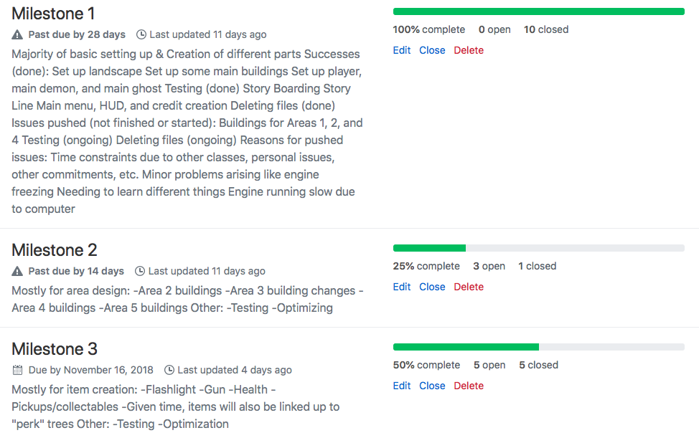
Milestones

Slide 3
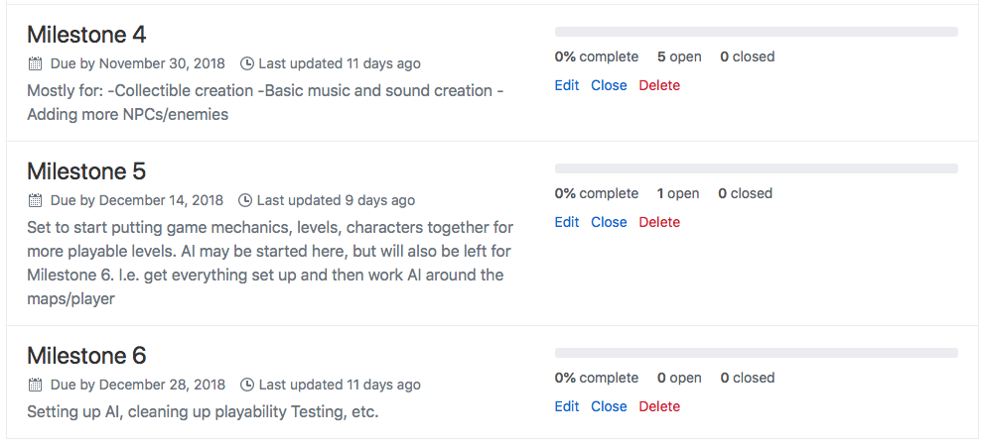
Milestones

Slide 4
Milestone 2
Oct. 19th to Nov. 2nd

Slide 5
Milestone 2: focus
1) Different Area Buildings
2) Deleting unused content/start content
3) Ensure source control works with GitHub
4) Update/Work on Milestones

Slide 6
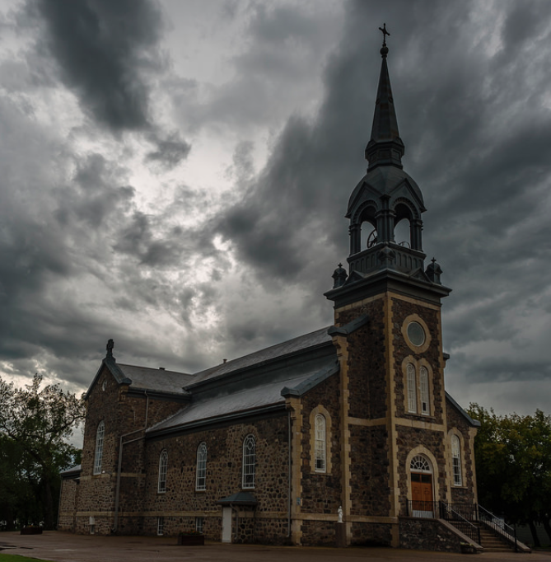
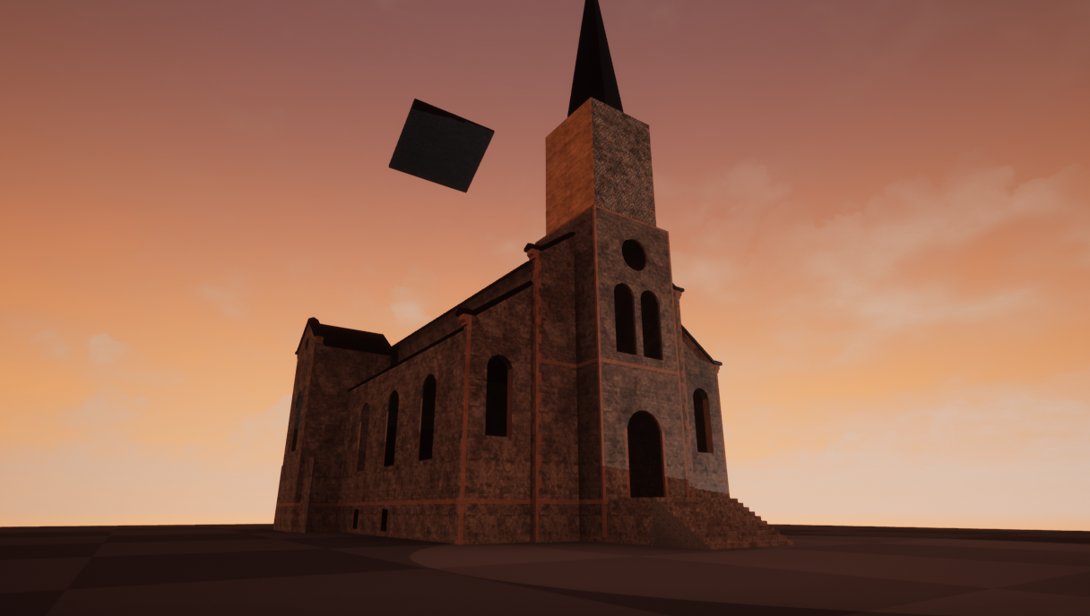
Area Buildings
Lebret- Sacred Heart Church
Church Created in Game

Slide 7
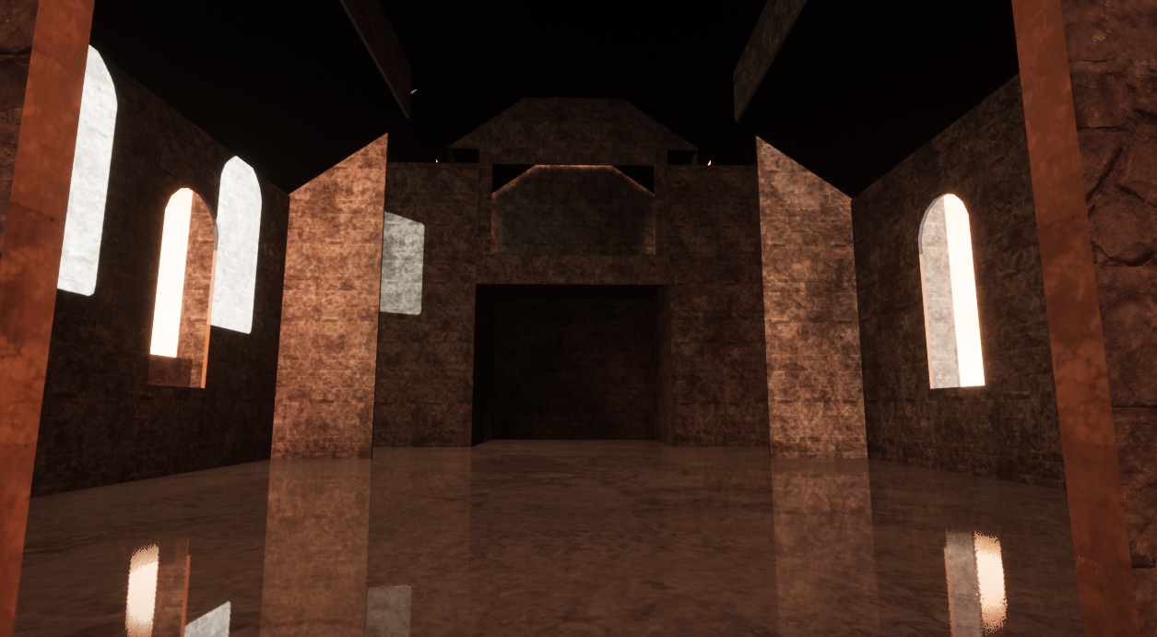
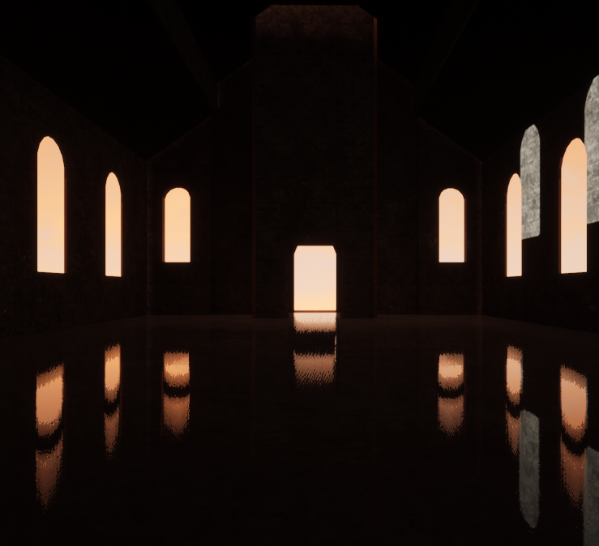
Area Buildings
Church: Interior

Slide 8
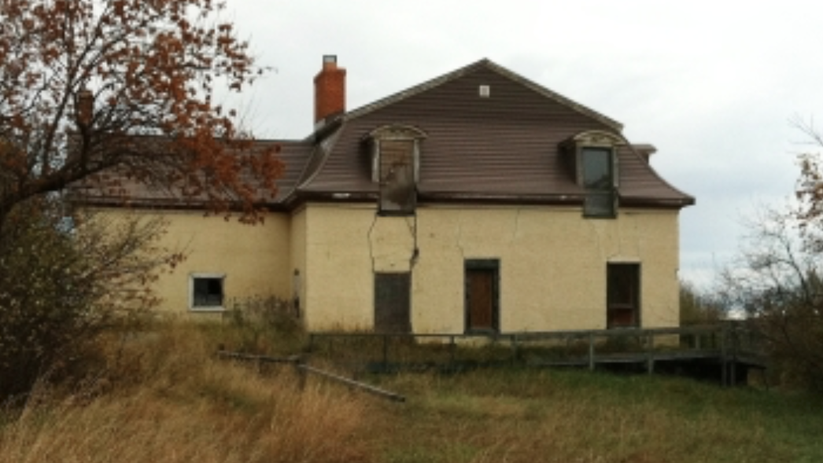

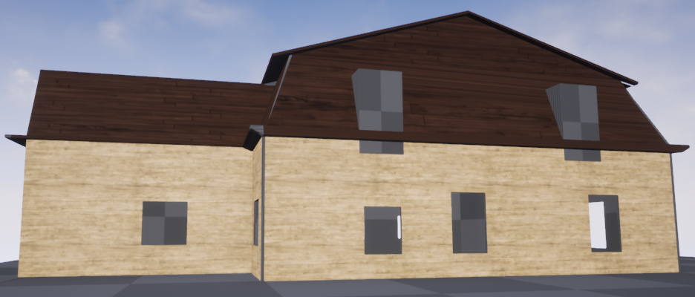
Area buildings
Camp Gilwell
Area 1 Cabin

Slide 9
Milestone 3
Nov. 2nd To Nov. 16th
Notes:
**Randomly generate where texts are, items are, placements, etc. Core static, other stuff different.

Slide 10
Milestone 3: focus
Item Creation
Upgrade Design
Pickups
Collectibles
Menus
Updated HUD

Slide 11
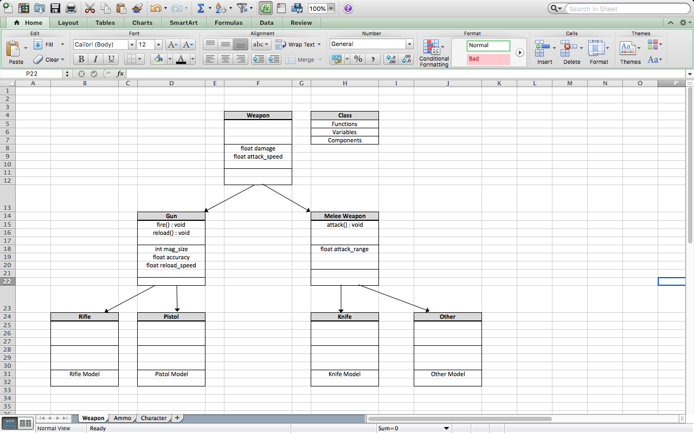
Weapon Classes

Slide 12
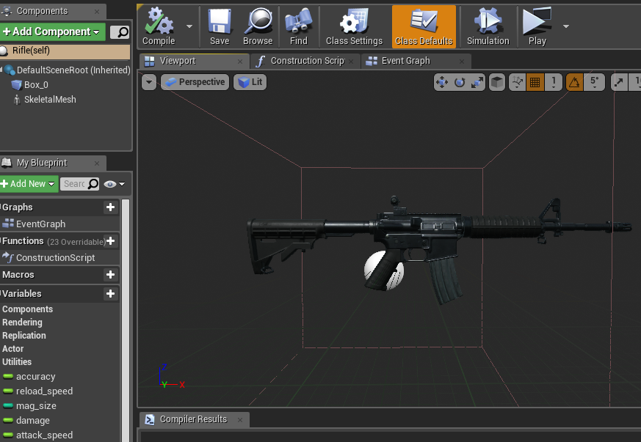
Weapon Examples

Slide 13
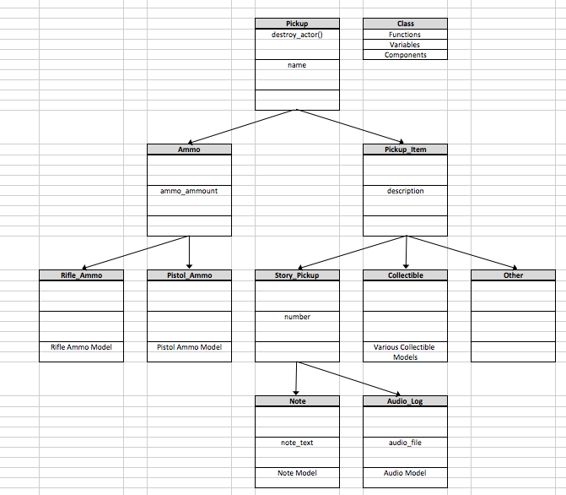
Pickup Classes

Slide 14
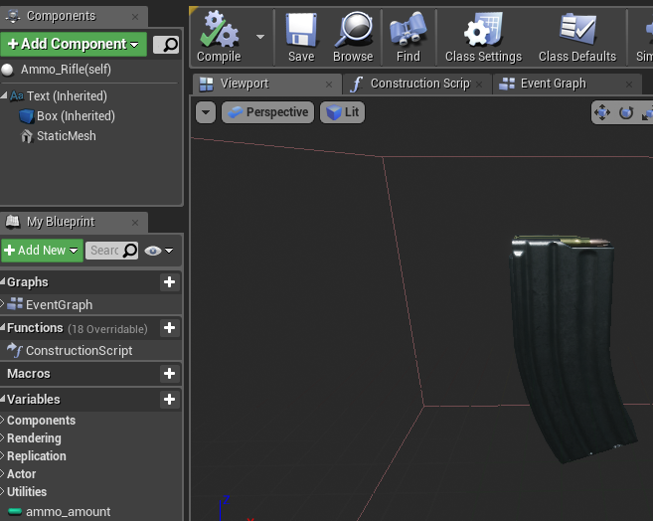
Pickup Example

Slide 15
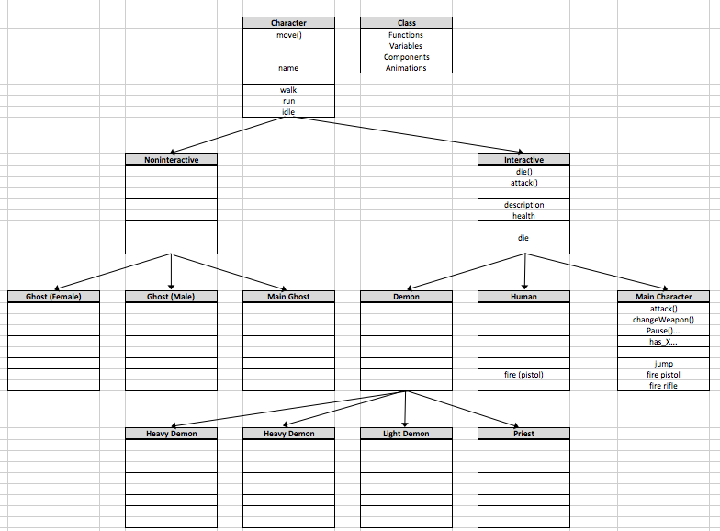
Character Classes

Slide 16
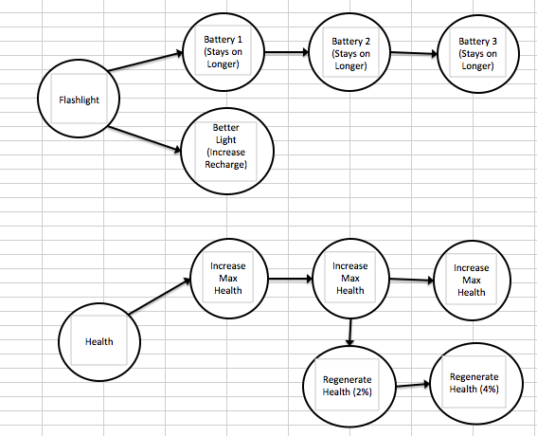
Upgrade Examples

Slide 17
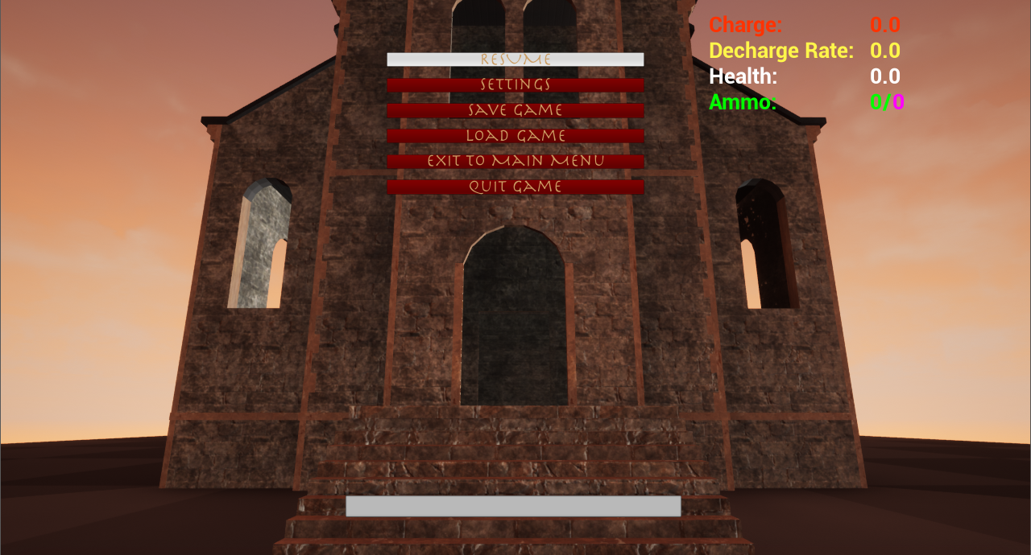
Menus/Updated HUD
Pause Menu

